Slide 1
Review Session 4
API-201, 10.08.21
Sophie Hill

Slide 2
Review sessions: new & improved!
Thanks to everyone who gave feedback on the Review Sessions in the mid-course evaluation!
Here are some concrete changes I’m making based on your comments (see my post in Slack for more detail):
Focus on bridging gap between class & PSets
Use small group work to encourage active engagement
Collect and address questions more systematically

Slide 3
What questions do you have on this week’s material?
Plan:
I will collect questions at start of session (and throughout)
In the last 10 minutes of our session, we will return to the list and decide as a group which ones to prioritize

Slide 4
Agenda
Measures of central tendency
Missing data
Excel skills

Slide 5
Measures of central tendency

Slide 6
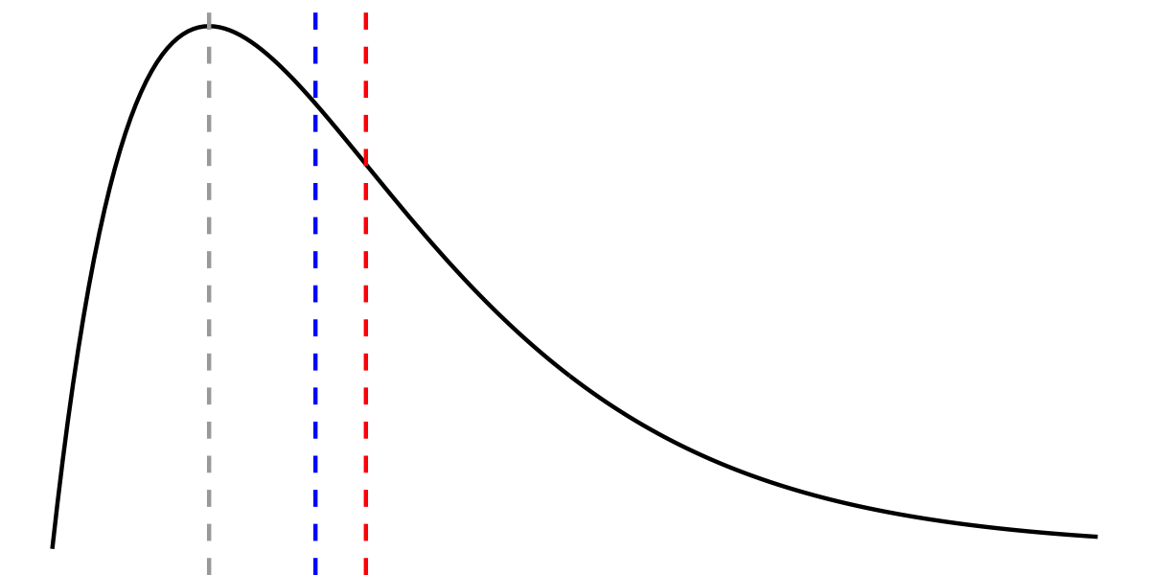
Measures of central tendency
Which line represents the mean, median, and mode of this distribution?

Slide 7
Measures of central tendency
The mode is show by the grey line.
Modal = most common value = highest point on the pdf!

Slide 8
Measures of central tendency
The mode is show by the grey line.
Modal = most common value = highest point on the pdf!

Slide 9
Measures of central tendency
The distribution is not symmetric, so the mean =/= the median.

Slide 10
Measures of central tendency
The distribution is not symmetric, so the mean =/= the median.
It has a long right-tail, so the mean is being dragged up above the median...

Slide 11
Measures of central tendency
Median
Mean
Mode

Slide 12
Missing data

Slide 13
Missing data
Suppose we conduct a poll of a representative sample of 1,000 US adults about their drinking habits. We asked how many alcoholic drinks they have per week - however, the response to this question is missing for 200 respondents. Among the other 800, we find that they report an average of 4 alcoholic drinks per week.

Slide 14
Missing data
Suppose we conduct a poll of a representative sample of 1,000 US adults about their drinking habits. We asked how many alcoholic drinks they have per week - however, the response to this question is missing for 200 respondents. Among the other 800, we find that they report an average of 4 alcoholic drinks per week.
Scenario 1: The data are missing because there was glitch in the survey software, which deleted every 5th response.
Scenario 2: The data are missing because some respondents decided to skip this question without answering.

Slide 15
Missing data
Discuss the differences between Scenarios 1 and 2. In particular, assess whether the missing data will cause you to under/over-estimate the average number of drinks per week among the population.
Suppose we conduct a poll of a representative sample of 1,000 US adults about their drinking habits. We asked how many alcoholic drinks they have per week - however, the response to this question is missing for 200 respondents. Among the other 800, we find that they report an average of 4 alcoholic drinks per week.
Scenario 1: The data are missing because there was glitch in the survey software, which deleted every 5th response.
Scenario 2: The data are missing because some respondents decided to skip this question without answering.

Slide 16
Missing data: missing at random
In Scenario 1, the 200 responses are missing at random. (It’s as if we took a random sample of 1,000 from the population, and then drew another random sample of 800 from that 1,000.)
Put another way: we have no reason to believe that the 200 response that were deleted would have been particularly low or high values.
In this case, 4 drinks per week is still a good (i.e. unbiased) estimate for the whole sample, and thus for the population.

Slide 17
Missing data: non-response bias
In Scenario 2, the 200 responses are not missing at random. High levels of alcohol consumption are stigmatized, so heavy drinkers will be more likely to skip the question compared to average drinkers.
In this case, 4 drinks per week would be an underestimate for the whole sample, and thus for the population.

Slide 18
Excel skills

Slide 19
You can do almost everything in PSet 4 Q1 just using tables...
To convert to table:
Highlight cells, then go Data → Filter
To find highest/lowest values:
Sort by variable descending / ascending
To count non-missing values:
Filter to exclude blanks

Slide 20
… but you might want to impress your future boss by learning how to do it with formulas!
What you want | Formula | Tips
How many non-missing values? | Use COUNT() to count cells with numbers, use COUNTA() to count any non-blank cell (including text). | First, check what the “missing values” look like. Blank cell? “NA”? If necessary, convert them to blank cells. Note: if you use COUNTA() on a whole column, it will count the header row! So you would need to subtract 1.

Slide 21
… but you might want to impress your future boss by learning how to do it with formulas!
What you want | Formula | Tips
The 7th highest / lowest value | =LARGE(B:B, 7) =SMALL(B:B, 7) | Make sure your variable is correctly formatted as a number! Note: in Excel, numbers are right-aligned.

Slide 22
… but you might want to impress your future boss by learning how to do it with formulas!
What you want | Formula | Tips
The name of the observation with a particular value, X | Find row number of the observation that has value X in column B: =MATCH(X, B:B, 0) Look up the value in that row in the name column, say, column A: =INDEX(A:A, rownum) | Take it step by step at first! Manually check that the lookups are working.

Slide 23
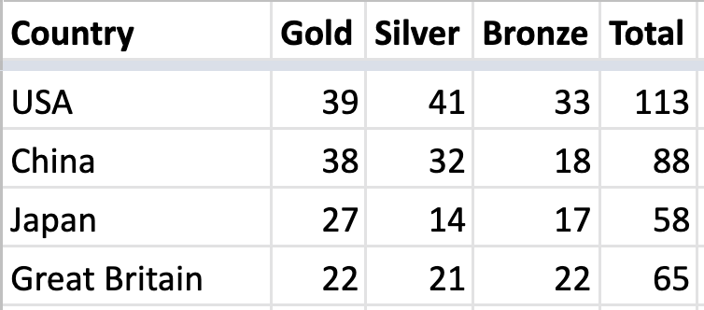
Let’s practice!
Example dataset: Medal tables from the Tokyo Olympics!
Link to Excel worksheet

Slide 24
FAQs

Slide 25
FAQs
What’s the difference between the correlation and the slope?
When does adding an observation increase/decrease the standard deviation?
What is the intuition behind the formulas for variance, correlation, etc.?

Slide 26
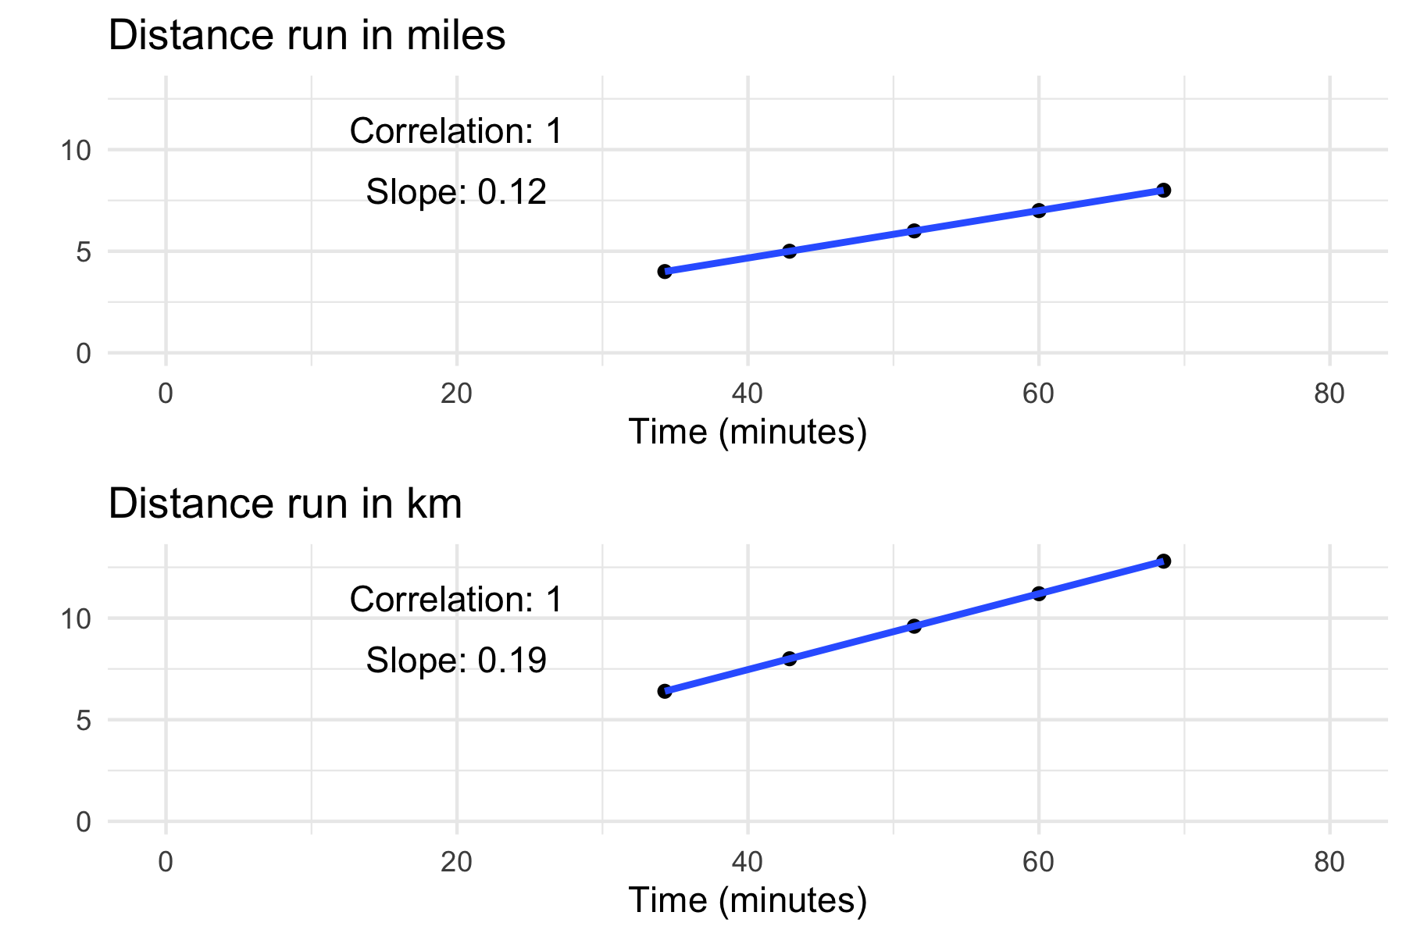
What’s the difference between the correlation and the slope of the line of best fit?
Suppose that you go for a 5-10 mile run every Saturday and you decide to plot your latest times vs distance covered.
All your times lie exactly on the line of best fit, which slopes upwards, so it’s a perfect positive correlation of +1.

Slide 27
What’s the difference between the correlation and the slope of the line of best fit?
Suppose that you go for a 5-10 mile run every Saturday and you decide to plot your latest times vs distance covered.
All your times lie exactly on the line of best fit, which slopes upwards, so it’s a perfect positive correlation of +1.
You’d like to compare times with your European friend, but first you’ll need to convert those distances into km.
What happens to the correlation?
What happens to the slope?

Slide 28
What’s the difference between the correlation and the slope of the line of best fit?
Changing the unit of distance has changed the slope of the line of best fit (it is steeper now).
But the points still lie exactly on the line, so the correlation is still +1!

Slide 29
What’s the difference between the correlation and the slope of the line of best fit?
Key differences:
Slope depends on units, correlation does not
Slope is about the steepness of the line, correlation is about the tightness to the line

Slide 30
When does adding an observation increase the standard deviation?
Here’s a sample of numbers: {5, 2, 5, 8, 3, 7}
Mean = 5
Standard deviation = 2.1

Slide 31
When does adding an observation increase the standard deviation?
Here’s a sample of numbers: {5, 2, 5, 8, 3, 7}
Mean = 5
Standard deviation = 2.1
Let’s add a new number, 4, so our sample is: {5, 2, 5, 8, 3, 7, 4}
Mean =
Standard deviation =

Slide 32
When does adding an observation increase the standard deviation?
Here’s a sample of numbers: {5, 2, 5, 8, 3, 7}
Mean = 5
Standard deviation = 2.1
Let’s add a new number, 4, so our sample is: {5, 2, 5, 8, 3, 7, 4}
Mean = 4.9
Standard deviation = 2.0

Slide 33
When does adding an observation increase the standard deviation?
Here’s a sample of numbers: {5, 2, 5, 8, 3, 7}
Mean = 5
Standard deviation = 2.1
Let’s switch that out for a new number, 1, so our sample is: {5, 2, 5, 8, 3, 7, 1}
Mean =
Standard deviation =

Slide 34
When does adding an observation increase the standard deviation?
Here’s a sample of numbers: {5, 2, 5, 8, 3, 7}
Mean = 5
Standard deviation = 2.1
Let’s switch that out for a new number, 1, so our sample is: {5, 2, 5, 8, 3, 7, 1}
Mean = 4.4
Standard deviation = 2.4

Slide 35
When does adding an observation increase the standard deviation?
Intuition:
Standard deviation = square root of the variance
Variance = average of the squared deviations
So the variance increases when the new value has a squared deviation that is above average, i.e. greater than the variance
So the standard deviation increases when the new value has a deviation that is greater than the old standard deviation

Slide 36
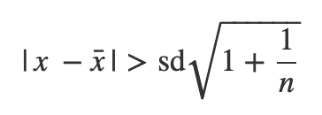
When does adding an observation increase the standard deviation?
Intuition:
Standard deviation = square root of the variance
Variance = average of the squared deviations
So the variance increases when the new value has a squared deviation that is above average, i.e. greater than the variance
So the standard deviation increases when the new value has a deviation that is greater than the old standard deviation
Note: this is a bit hand-wavy! If we derive this formally we find a slightly stronger condition: SD increases if:

Slide 37
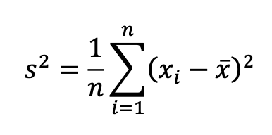
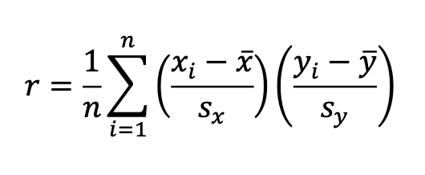
What is the intuition behind these formulas?
Variance
Visualization
Correlation
Visualization

